Slide 1
FRM Data Strategy and Analytics – Project Brief
Leveraging analytics to generate insights for Farmers
6 September, 2018

Slide 2



Overview and Approach – FRM data
Background
Farmers’ data captured at Samriddhi Centers on kisandost.com portal
Total number of farmers for which basic demographic details captured: ~ 8.5 L
Need to perform a feasibility study on the existing data and identify the analytical opportunities for improving Mahindra’s presence in Agri Sector
Current Data Challenges
Irregularities in data capturing process – portal based on very old system
Duplication in unique identifiers for Farmer’s data - Farmer Code, Mobile, Name etc.
Junk values captured in many cases for fields like Occupation, Family Size, Education etc.
Majority of farmer’s data captured when only Soil Testing is done at Samridhhi Centres
Opportunities and Recommendation
Two analytics endeavors which can be taken up in future :
Recommendations:
Data capturing process can be replicated from Mahanayak program
Data validation exercises need to be taken up at highest priority – A missed call campaign can be initiated where the farmer gets some discount on their next purchase, will increase authenticity of data as well as higher sales opportunity
Lead Prioritization for Call Centres
Whom to Contact and When to Contact
Current Call contractibility: ~ 20-22%; Conversion: ~ 10 – 15%
Approx. 1000 farmers contacted daily but only 20 – 30 buy
Objective would be to improve contactibility and final conversion
Cross-Sell/Up-Sell of products
Many farmers are existing buyers for AGRI products
Opportunity to cross-sell depending on the farming cycle and crops grown
Holistic data mart needs to be created

Slide 3

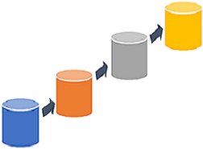


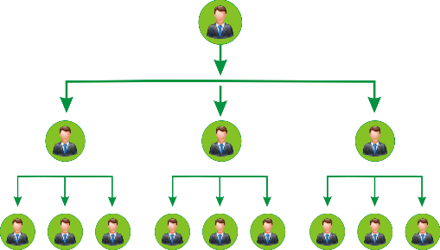
Robust Data Management Strategy: Effectively Capture, organize and leverage Farmers’ data
Consistent and Integrated Data Mart for all Agri-Businesses
Enriched Data Collection and management Plan
Mahanayak
Aamdani Badhao
Individual Business Transactions (Crop Care, Seeds etc.)
My Agri Guru
FRM/CRM (Kisan Dost)
Data Health Check and Enrichment
Farmer data collection in incremental stages
Data Mart
Reviving Contactibility Data: Missed call campaigns, discount SMS etc.
Referral and Incentive programs
Benefits
Common Database to capture and utilize data from all business units
Single unique Code for each farmer to get 360º view of his relationship with Mahindra
Monitoring Farmer’s agricultural cycle and recommending products accordingly

Slide 4
Timeline
Idea generation, Identification of opportunities, Stakeholders nominated
Initiated way-forward approach and data access requested
Preliminary Data Exploration initiated;
Identified the key tables in FRM
Jul ’18 – W2
W4 Jul ’18
Aug ’18 – W4 (ongoing)
Jul ’18 – W3
Aug ’18 – W2-3
Sep ‘18
Stakeholder connect – Scope Discussion
Data Access provided for FRM (33 tables in SQL DB); CRM data access reinitiated
Data Quality Health-Check and Way-forward approach finalization

Slide 5



Hitting the Road… Devising strategy for data enrichment, campaigns and increasing Farmer Base (For two states)
Objective and Initial Approach
Initiating exploratory analysis and perform data quality audit to enrich the captured fields and creating data strategy for incremental capturing of Farmers’ data
Develop and plan campaigns and events (using multiple channels like Mobile campaigns/ Paper Ads etc.) to improve Mahindra product’s reach to Farmers and enhance MASL presence
Designing referral programs to increase farmer base and acquire new farmers in MASL Landscape
Two states selected for analysis – Maharashtra & Madhya Pradesh
Both are amongst the top states in number of farmers on-boarded
Quality of data better as compared to other states
The Three Stages
Following would be the three layered approach to strategize and realize analytical insights based on Farmers’ data
Data Enrichment Strategy
Develop Campaigns and Events
Referral Programs/ New Farmer On-boarding
Data Health-Check and evaluation
Data Completeness validation
Revamping Data Collection Process
Improving contactibility data
SMS/missed call based campaigns for quality data
Conversion rate improvement by contacting the right person
Algorithm based Product recommendations
Incentive based referral program for farmers
Stage-wise data capturing with basic inputs taken from referral

Slide 6

Core Team – FRM Data Strategy and Analytics (Nominated Stakeholders)
Businesses
Analytics & Strategy
IT – Data Integration
Samriddhi - Vivek Chhabra
Crop Care - …
Seeds –
…
IIC –
Shiv Kumar
Jiten Shah
Satyarth Sharma
FRM –
Ahfaz Shaikh
CRM – Rakesh Dhar, Samik Chakrobarty
Apps-
Responsibilities

Slide 7
Operating Model – Engaging business with analytics and strategy team
CoE Team Performance (Empowering existing processes with advance analytics)
Agri Business Team
Extensive data and business functioning understanding
Problem/Analytical Opportunities identification
Current Challenge - Limited usage of analytics tools
Roles: Detection, Data Analysis & Monitoring
Problem Solving Team
Strategic planning and creating support system to facilitate smooth business decision making
Validation of problem from field data
Rectification measures and corrective actions proposition
Roles: ….
Collaboration on identified problem statement
Data Science Team:
Empowering Business team with Predictive and Prescriptive Analytics with help of statistical methods based insights
Use of Advance Tools – SAS, R and Python
Empowering insights with right resources (Data Scientists, Statisticians etc.)

